Slide 1

K. K. Wagh Institute of Engineering and Education Research
Dept. Of Computer Engineering
Automation of a Wheelchair Mounted Robotic
Arm using Computer Vision Interface
Guided by-
Prof.
By-
Jayashree Ahire, TE- B (02)
A.Y. 2018-19 Sem II
Automation of a Wheelchair Mounted Robotic
Arm using Computer Vision Interface

Slide 2
Format of Presentation
Introduction
Aim & objective
Literature Review
System Architecture/ working model
Algorithm
Applications
Future scope
Conclusion
References
Any other point according to seminar topic
advances in technology, problem resolution, product design and project status.
<Seminar Title>

Slide 3
I. INTRODUCTION
Helps people with upper body mobility to perform daily tasks
A robotic arm with six degrees of freedom
An electric wheelchair
Computer system and two vision sensors:
One vision sensor detects the coarse position of the colored objects placed randomly on a shelf located in front of the wheelchair by using a computer vision algorithm.
The other vision sensor provides fine localization by ensuring the object is correctly positioned in front of the gripper.
The arm is then controlled automatically to pick up the object and return it to the user
An average task completion time of 37.52 seconds is achieved.
<Seminar Title>

Slide 4
Beneficial for:
People suffering from upper body movement disorders such as Amyotrophic Lateral Sclerosis (ALS), Parkinson’s disease, Progressive Muscular Atrophy (PMA).
Enhance the manipulation capabilities for electric wheelchair users and make them feel more independent.
<Seminar Title>

Slide 5
wheelchair mounted robotic arms (WMRA) available in the market such asJACO Robot arm by Kinova Robotics [1] and iARM by Assistive Innovations [2] utilize remote controlled interface such as joystick to control the arm. This might be challenging to operatefor users suffering from motor neuron diseases and in many cases it can consume a lot of time and effort to successfully grasp the object. They are also very expensive usually run into thousands of dollars
<Seminar Title>

Slide 6
Index Terms
Assistive Technology
Automation
Computer Vision
Image Processing
Robotic Arm
Vision Sensor
human-computer interaction (HCI)
The estimated cost of the system is around $1500
<Seminar Title>

Slide 7
Consists of:
a robotic arm with six degrees of freedom
an electric wheelchair
a computer system
two vision sensors
<Seminar Title>

Slide 8
goal of the research
to develop a system that can deliver the desired object to the user with minimal to no supervision.
the system is designed to be user independent and can figure out the position of the object on its own using an object detection algorithm and can complete the task of picking up the object and returning it to the user under one minute.
<Seminar Title>

Slide 9
Process
The coarse location of the target object is calculated by using image obtained from the vision sensor located above the arm
localization is achieved by using a vision sensor near the gripper.
The obtained coordinates are fed to the robotic arm using a serial communication interface to move the arm in the right direction.
<Seminar Title>

Slide 10
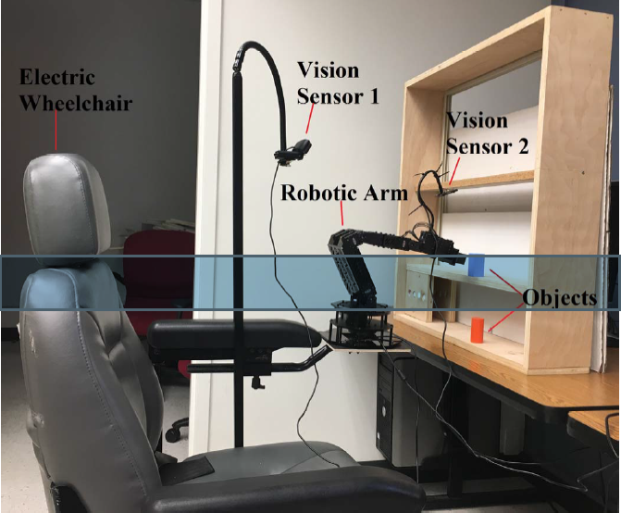
System Description
<Seminar Title>

Slide 11
Robotic Arm
Trossen Robotics PhantomX Reactor Robot Arm
Using an Arduino compatible advanced microcontroller called Arbotix-M robocontroller
Has eight AX-12A dynamixel actuators for controlling different parts of the arm.
Each servo has sensors to track its speed, temperature, shaft position, voltage and load
The servo motor at the bottom is used to move the arm in the horizontal direction (left and right). The shoulder has dual servo which moves the arm in the forward and backward direction. The elbow also has dual servo which controls the up and down movement of the arm
The wrist angle and wrist rotate have one servo each. The arm has a parallel gripper controlled by an AX-12 servo which can hold and release the object
The arm is powered by a 12V 5amp power supply and is connected to a computer system via a FTDI cable.
<Seminar Title>

Slide 12
A serial connection is made between the computer system and the robotic arm in order to communicate with the robotic arm.
This was achieved by using PySerial, a python serial port access library.
The serial connection has a baud rate of 38400.
The data packet which is 17-byte long was sent serially from the computer to the Arbotix-M robocontroller to control the movement of the arm.
The 17-byte data packet includes:
  the header (0xFF/255)
  X-axis coordinate
  Y-axis coordinate
  Z-axis coordinate
  wrist angle
  wrist rotate
  Gripper
  delta byte
  check sum.
Each of the servo motor can be controlled by varying the 17-byte data sent to the arm accordingly. A short delay is introduced after every serial write command is performed to ensure the reception of the 17-byte data by the robotic arm.
<Seminar Title>

Slide 13
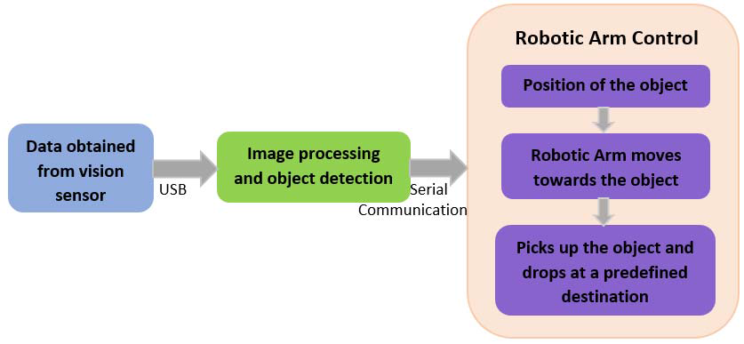
Block diagram of the system
<Seminar Title>

Slide 14
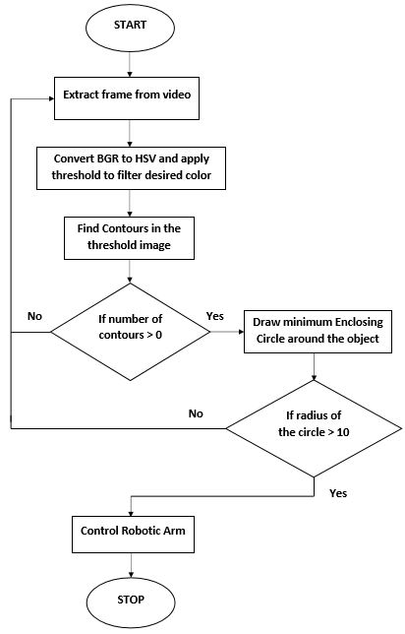
Flowchart for Computer Vision Algorithm
<Seminar Title>

Slide 15
Vision Sensors
Two vision sensors (USB webcams):
  Logitech HD c920 webcam (vision sensor 1):
    Mounted above the robotic arm facing the shelf located in front of the arm
    The vision sensor 1 captures the video of the arm and the shelf in real time.
    Frames extracted from this video are processed and the position (X, Y) of the target object is calculated.
    This data is used for coarse positioning of the robotic arm.
  A robot VGA webcam (vision sensor 2):
    Mounted above the gripper using a 200 mm gooseneck.
    Captures a close-up video of the target object.
    Frames from this camera are captured only after the arm is moved to the position indicated by vision sensor 1.
    Used to position the gripper exactly in front of the object so that the object can be picked up correctly.
<Seminar Title>

Slide 16
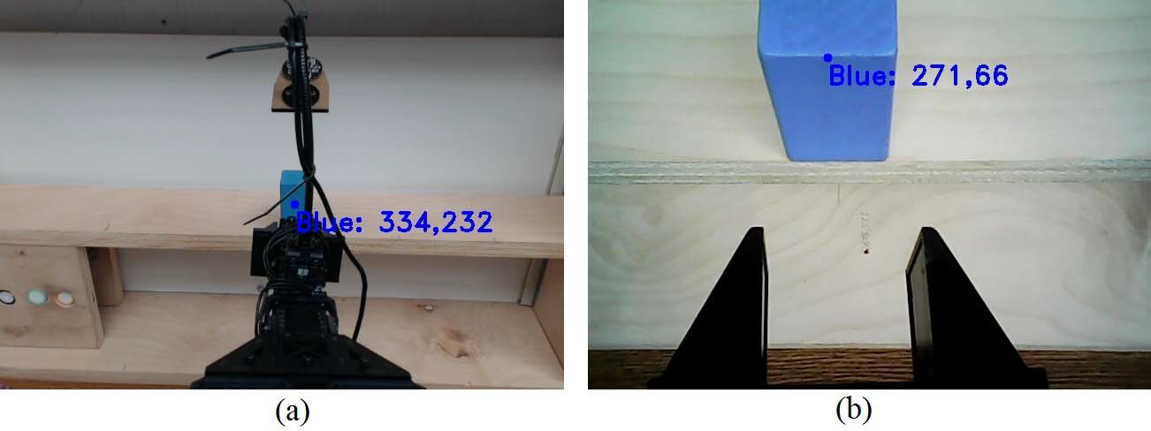
The resolution of the images in both the camera is 640 x 480pixels and the webcam captures around 30 frames per second.
(a) Image captured by the vision sensor 1 (b) Image captured by the vision sensor 2
<Seminar Title>

Slide 17
Computer Vision Algorithm:
Programmed to move towards the position of a specific colored object.
The color detection algorithm is written in Python using the OpenCV library.
The vision sensor captures the real time video of the robotic arm and the object.
The video is extracted frame by frame and each of the frame is processed through a series of steps to detect colored objects in the frame.
<Seminar Title>

Slide 18
Each frame is converted from BGR (Blue Green Red) image to HSV (Hue, Saturation and Value) image.
A specific color is filtered by applying a lower and upper limit threshold to the HSV image [8].
Different colors have different range of hue values. Hence by providing the appropriate range of hue values, different colors can be detected simultaneously.
<Seminar Title>

Slide 19
The resulting image is eroded to remove the noise present in the image and dilated to fill the gaps in the image. The threshold image is scanned to check the presence of contours. In case a contour is located the position of the contour is found by calculating moments [8]. A minimum enclosing circle is drawn around the object and the center of the circle corresponds to the X and Y coordinates of the position of the object. The color detection algorithm is extended to capture data from two vision sensors and combined with the robotic arm control code to perform the desired task.
<Seminar Title>

Slide 20
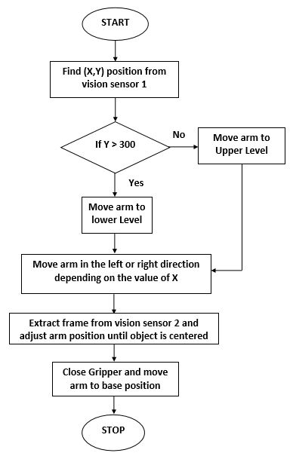
flowchart implementation of the computer vision algorithm.
<Seminar Title>

Slide 21
III. EXPERIMENT AND RESULTS
<Seminar Title>

Slide 22
ROS
Robot Operating System (ROS) is a flexible frame
no single individual, laboratory, or institution can hope to do From the robot's perspective, problems that seem trivial to humans often vary wildly between instances of tasks and environments. on their own.work for writing robot software.
collaborative robotics software development.
<Seminar Title>

Slide 23
The iArm robotic arm:
Maximum lifting weight 1.5 kg (3.3 lb)
Multiple operational functions and fitting options
Special drinking and feeding menu
Average human arm length
Strong structure, compact design
<Seminar Title>

Slide 24
Each aluminum actuator contained within the carbon-fibre frame of our robotic arm contains torque, position, current, temperature and acceleration sensors, helping to prevent any human near or operating the robotic arm from being harmed by it. Our KINOVAⓇ Ultra lightweight Series offers embedded controllers and provides intuitive Cartesian control, adding ease to versatility.
Weighing in at just 4.4 kg, the KINOVAⓇ Ultra lightweight robot gives your team a plug-and-play option developed with open architecture, and compatible with both ROS and our software, giving you performance, flexibility and ease all in one.
<Seminar Title>

Slide 25
Contour is a boundary around something that has well defined edges, which means that the machine is able to calculate difference in gradient (significant difference in magnitude of pixel value), try to see if the same difference continues and forms a recognisable shape and draw a boundary around it. Opencv can do it for a lot of shapes and they are shown in the link below.
Just imagine how you do it with your eyes. You're in a room and you create a boundary in your mind when you see a frame or a monitor or a ball. Exactly the same way contours work in opencv. Various algorithms are used for this purpose.
If you need examples and how contours are represented in opencv, here's a link.
<Seminar Title>

Slide 26

THANK YOU!
ANY QUESTIONS?
<Seminar Title>

